Slide 1
IMPROVE LINKEDIN MESSAGING
DECK BY CHINMAY MATHUR

Slide 2
ABOUT PRODUCT:
LinkedIn mission is to connect the world's professionals to make them more productive and successful. Messenger is a powerful tool for people to connect through sharing of messages to reach out to specific people or audiences through one to one communication. Considering the spamming of people through messages, its all the more important to improve it in order for keeping the connection meaningful through messaging on messenger
User Pain Points
Lot of irrelevant messages or reachouts clutter their messaging section
Can’t tell if message has been seen/received or not so should wait for response or not
Dont get replies for messages sent so dont find it relevant to look at messaging
Repeatedly have to ask the same information again and again to each recruiter and provide the same information back in return
METRICS
Percentage of LinkedIn daily active users using LinkedIn messages
Number of messages sent per day
Ratio of messages sent/messages recieved
Amount of time taken by the receiver to respond

Slide 3
USER PERSONA
Job seeking users: Users which use LinkedIn messages to connect with recruiters and for referrals multiple times a day
Recruiters: They answer several messages in a day hence high frequency users
Sales personal: Use LinkedIn messages to send sponsored and promotional offers to users
Average users which do not use LinkedIn messages enough only to reply to notifications if any

Slide 4
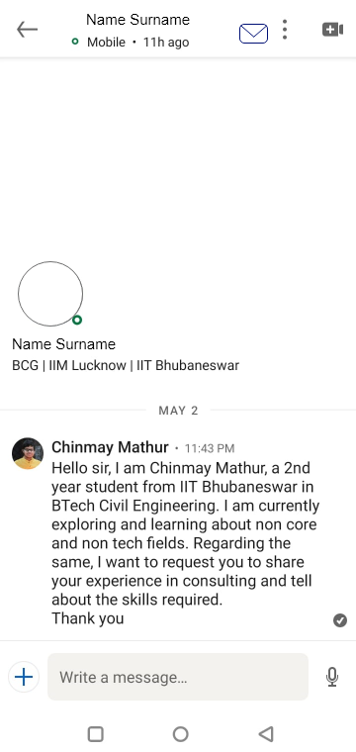

FEATURE 1
Within the message screen the new options include mail and message seen/delivered options. The target user is the job seeking user which forms the majority of the user base of LinkedIn.
The read feature tell the user if the recipient has read the message and has ignored it, a grey tick implies the message is delivered, blue implies the message is read.
The mail-in-message features redirects the recruiter/ job seeker to others registered email for better connection and taking the conversation further to the next step.
These features are aimed to increase the engagement as these feature push both the users to respond and use LinkedIn as a starting platform to look for jobs instead of direct mailing or using other platforms
wireframes

Slide 5
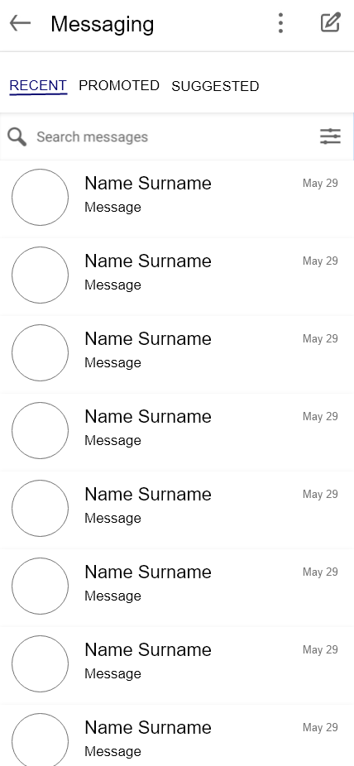
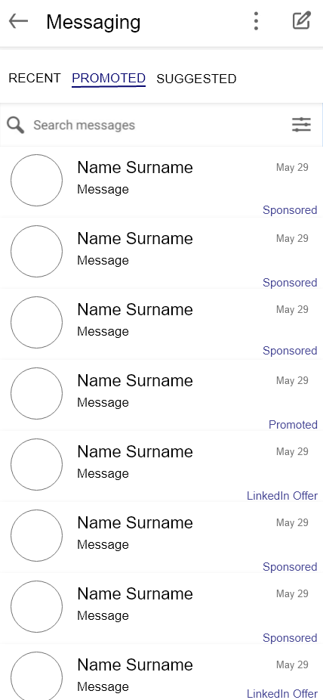
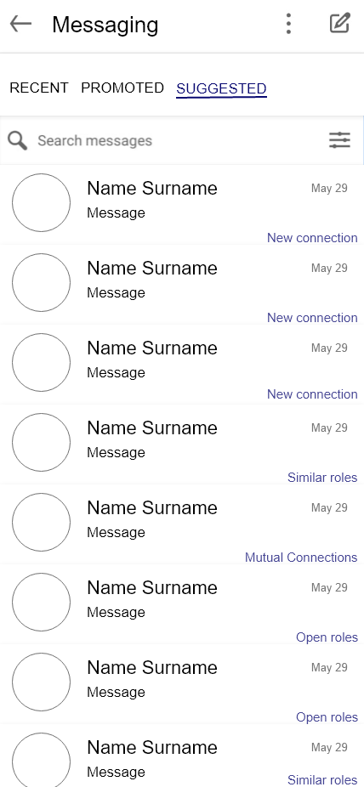
FEATURE 2
By sorting the messages into categories, the user is more likely to use the feature. It also incorporates the notification feature where linkedin asks to reach out to a new connection under the suggestion tab. This feature benefits all types of users by letting them browse by their purpose and priority
This feature focuses on engagement as it encourage the user to explore more messaging and hence spend more time on it. It also smoothens the experience of a user hence also helps with retention
wireframes

Slide 6
OTHER FEATURES
A tutorial for the first time users to tour the message feature and pop ups to explore and encourage to use it. Category: Activation, Engagement
Option to set a reminder to reply to seen messages to help not forget. Category: Engagement
Sharing of progress with mentors on a group chat and sharing profiles and referrals to recruiters. Category: Referral
Save pre-written messages for quick use instead of typing the same message multiple times hence saving time. Category: Engagement
CONCLUSION
Most features which would help the users most are from engagement category, mainly to prioritise and organize the messages they get in order to use the messaging more effectively, this in return would increase the traffic on LinkedIn as a whole helping it achieve its goals and missions

